Slide 1
Medium/Long Term Trading Models: Swing Trading with Dip Trip, Coiled Spring & Regime Shift Scenarios
By: Xu Chen (Jasmine)
01 April 2023

Slide 2
Group #1150
Group Members:
Rajeev Kuma Sahu
Jasmine Xu Chen
Kudakwashe Jisinau

Slide 3

Government Issued Photo ID

Slide 4
Project Motivation
Lack of enough reserach paper on mid/long term trading system
To confirm the best trading strategy in terms of risk and return by comparing various combinations for scenarios under consideration.
We would like to review regime detection concepts adopted from Srivastava and covers application steps for K-means clustering algorithm if it can enhance the return and reduce risks compared with passive trading logic

Slide 5
Project Goal and Importance
To build trading system to calculate risk & return using Indian Nifty 50 index data (2008-2023), focusing scenarios like: Dip Trip (buy & hold), Coiled Spring etc
Improve the traditional swing trading approach by applying Machine Learning techniques (k-means clustering)
Proposed a novel methodology that combine various scenarios from relative long (dip trip) to relative short term strategy (coiled spring) as well as regime detection

Slide 6
Literature Review/Background
We begin by giving a general theoretical framework on Swing Trading features/scenarios and implementation process and procedure
We deep dive into Swing trading domain and review various applications including market trends and stock selection for swing trading
We review regime detection concepts adopted from Srivastava and covers application steps for K-means algorithm
Look at various approach to handle regime shifts around the world and outline the importance of market regime in trading systems

Slide 7
Assumptions and Choice of Technology
Assumptions:
The underlying counters remain fundamentally sound
No transaction cost
No borrowing costs
The buying price is the closing price.
Risk free rate of return is zero.
Technology:
Python: internal tool for visualization, data retrieval from Yahoo API, and modelling including system development
Excel: For basic analysis

Slide 8
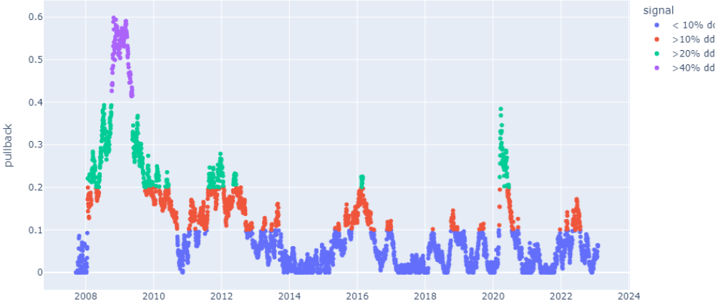
Dip trip method
Strength/Advantages The impact of short-term volatility is reduced as investors focus on the long-term returns of their investments. Simple to implement | Weakness/Limitation It needs strict implementation and might result in missed chances to buy or sell assets Holding a prolonged period expose investors to potential long-term risks due to market shifts, such as changes in interest rates, economic conditions, or political instability. No cut loss will cause capital vulnerable to price drop
Assumptions specifically to this method Assume we can only buy when the pullback value is > 10%, 20% or 40% of the all-time high value at that point of time. If already an order opened with the same amount of pullback (e.g: > 10% but <20%), we will not open a new buy order, however new order can be placed at 0 borrowing costs if pullback is another category ( e.g: between 20% to 30%) Order to be closed when price reached a new all-time-high value.

Slide 9
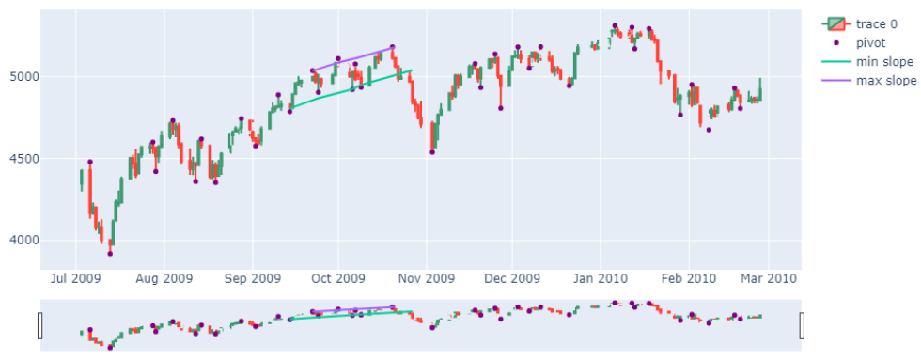
Coiled Spring method
Breakdown
Strength/Advantages Potential for higher returns Reduced risk Flexibility to apply to a wide range of stocks Time-saving: coiled spring trading requires relative less time to monitor the trades. | Weakness/Limitation Market volatility: Coiled spring trading assumes market is rationale, so undervalued stocks will eventually make a strong corrective move to its intrinsic value Time commitment & Reliance on fundamental analysis to choose specific fundamentally sound company, Limited diversification : Coiled spring trading typically involves a small number of stocks for an extended period of time.
Assumptions specifically to this method Detect Pivot point : => By comparing the # of forward candle and # of backward candles. e.g: 2 points in our example Predict breakout/breakdown point: Used # of candles to draw the regression line to detect min and max pivot points e.g: last 20 or 30 points in our example Note: selection of number of candles are subject to trader’s preference, risk tolerance, and trading strategy

Slide 10
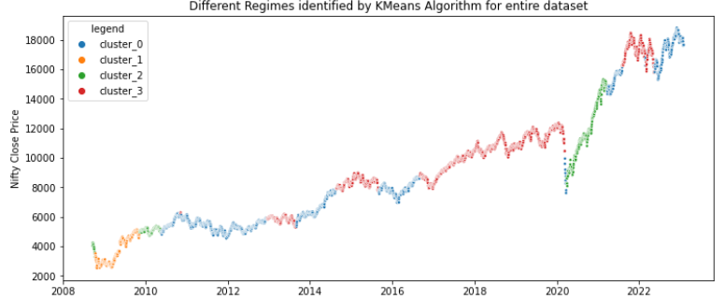
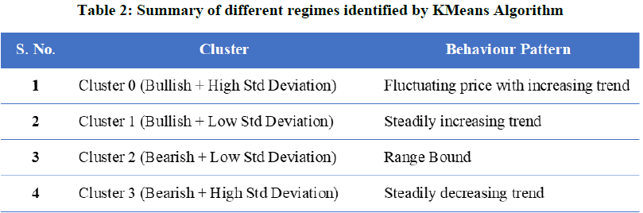
Regime shift detection model
Strength/Advantages Widely used in various industry Machine learning technique Relevant research paper available as foundation | Weakness/Limitation Limited data: yahoo finance data only starts 2008 for the Indian Nifty 50 index data Limited understanding: difficult to identify and predict regime shifts. Nonlinear dynamics due to external and internal factors
Assumptions specifically to this method Assume # of past day return, e.g: 250 days Assume # of centroid as beginning for K-means clustering. e.g: 4 clusters as common practice Assume split of train and testing dataset e.g: 40% vs 60%

Slide 11
Peer Review Feedback
1. Goal for swing trader/investor may not always be “ensuring portfolio positive portfolio returns”
Our final system/strategy proposed incorporate both risk and return perspectives and also consider utility function of trader/investor.
2. Identify which “regime shifting model” will be used in the objectives section – basically an explanation of the logic used in your code
Section 2.2 clear ascertain regime shift modeling approach and articulate on the logic for implementation. ML algorithms are used

Slide 12
Peer Review Feedback Cont’d
3. Do not see the point of going over papers which cover technical analysis methods different than those that are subject of your paper
Technical analysis used mainly to detect buy signals such as breakout / breakdown and bull/bear detection, as well as volatility for regime detection
We narrowed down our review to Swing trading theoretical framework including features and implementation process.
4. May want to use synthetic data – using parametric or non-parametric methods to test your strategies and stress test 2008/ 2020 periods.
We proposed this as areas for further development or research

Slide 13
Summary of Results & Discussion
We managed to develop several swing trading system with each of the methods and its permutation with others with stats below:
In terms of return: Best: Pure dip trip method (21.34%), Worst: pure regime shift (5%)
In terms of risk: Best: Dip trip with the coiled spring method (1.6), Worst: pure regime shift (0.52)
High mean & standard deviation detected for last two methods.

Slide 14
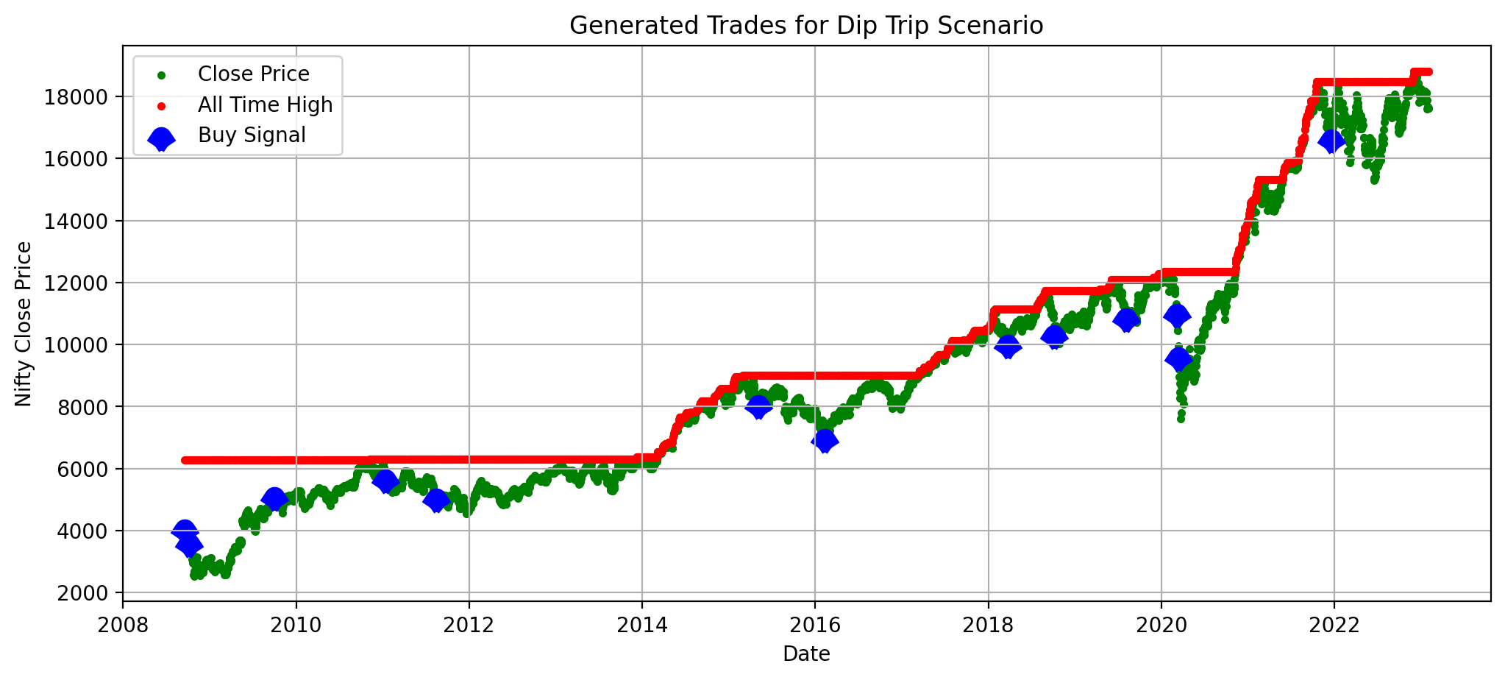
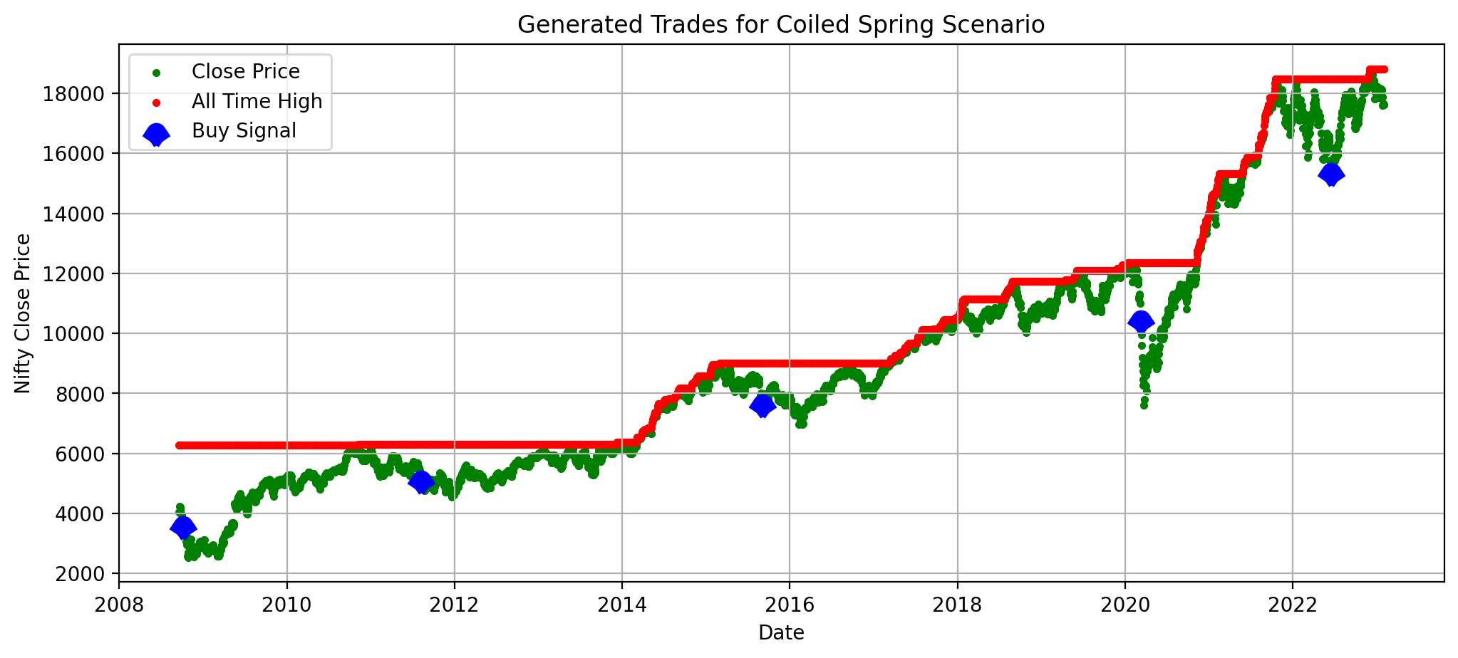

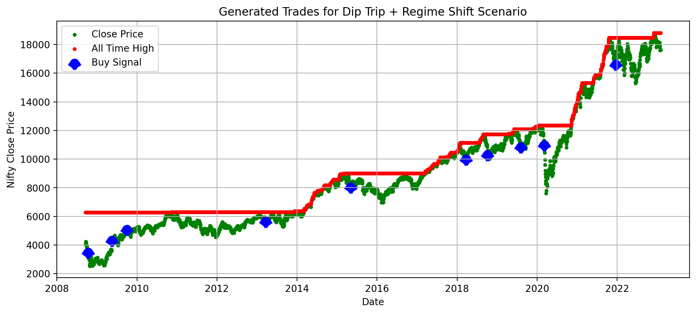
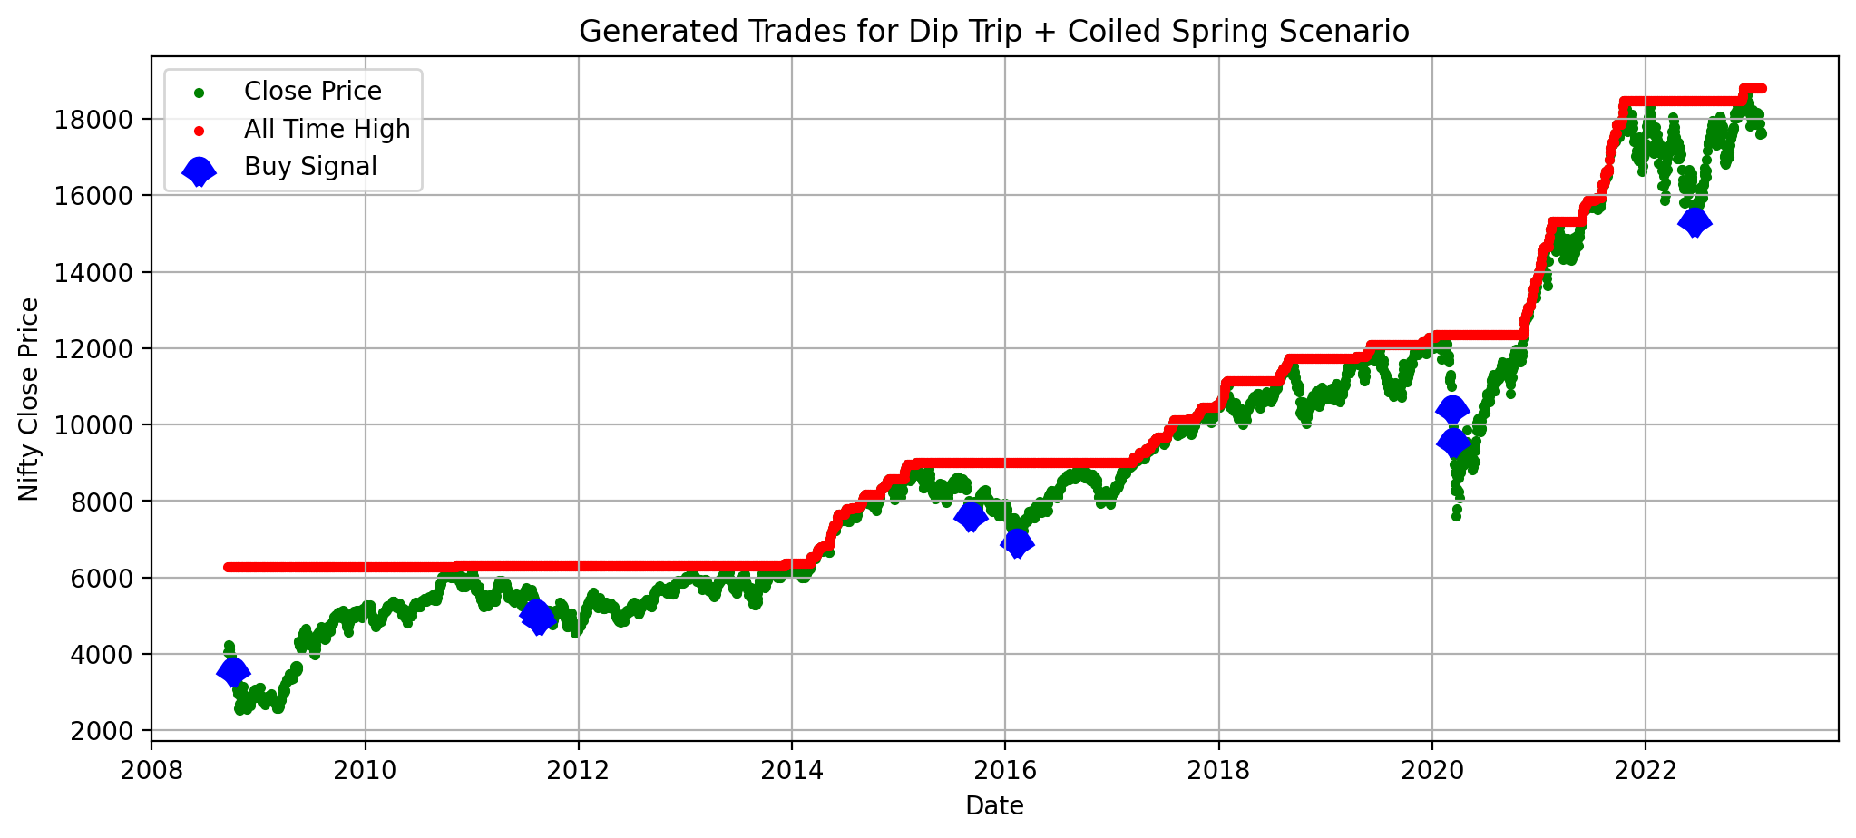
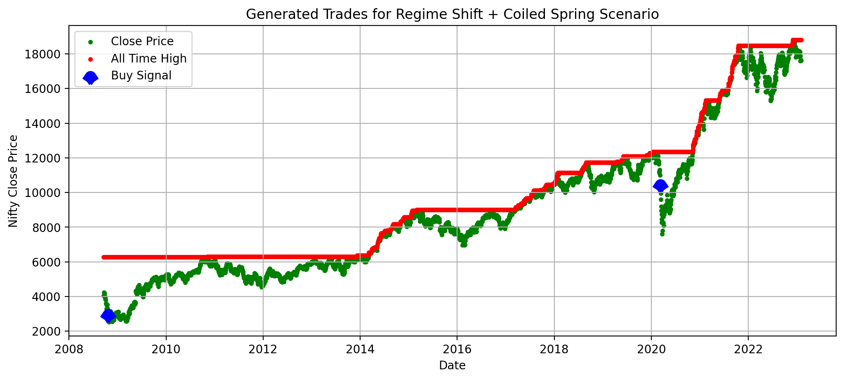
Trades generated in different scenarios

Slide 15
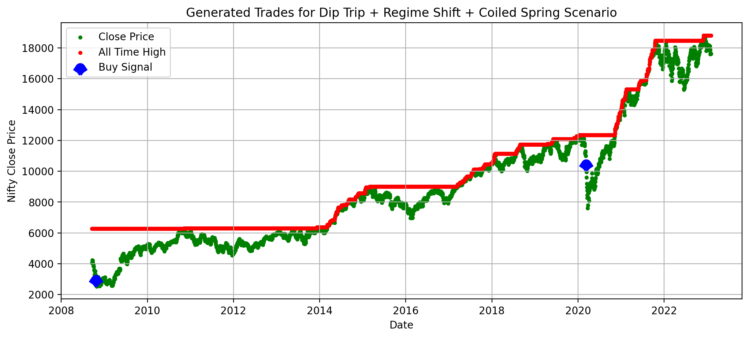
Trades generated in Dip Trip +
Regime Shift + Coiled Spring Scenario

Slide 16
My Contribution in project
Defined the research theme and direction after own background reserach.
Outlined the project planning with the team.
Focus on dip trip methodolgy end to end, including background, implementation, results analysis and reports.
Analyzed my teammates’ other methodology results, and support to add assumption in reports.
Actively involved in discussion with teammates and implement merging the implemementation to be a noval solution.
Overall review whole reports to be aligned with expected results

Slide 17
Conclusions
Based on the one counter data and with the assumption mentioned above, we conclude that
Passive trading still exhibits remarkable performance due to its stable return and relative less risks
Adding more restrictions might not receive the equivalent return,
Dip trip is long term, Coiled Spring is relatively short term and regime shifts are hard to capture the steady trend
Hence the combination pulled down active trading performance.

Slide 18
Future Scope of Work
Include other swing trading strategies such as bear hug, finger finder, power spike to build a more robust trading system.
Evaluate the performance of this trading system on different indexes such as S&P 500, Dow Jones, FTSE100, Nikkei 225 etc
Backtesting this trading system to check performance on different time periods such as 10, 15 or 20 years and stress periods e.g 2008/ 2020
Consider varied candles in coiled spring scenario to identify the pivot points and possible break out or break down, ascertain if we reach different conclusion.

Slide 19
The end!! Thank you for your time.

Slide 20
Appendix
Appendix A: Python-Code/Jupyter-Notebooks
1. Dip Trip: Code_link 2. Coiled Spring: Code_link 3. Regime Shift: Code_link 4. Comparison of Scenarios: Code_link
Appendix B: Trades generated using Dip Trip scenario

Slide 21
Appendix C: Trades generated using Coiled Spring scenario
Appendix D: Trades generated using Regime Shift scenario
Appendix E: Trades generated using Dip Trip + Regime Shift scenario

Slide 22
Appendix F: Trades generated using Dip Trip + Coiled Spring scenario
Appendix G: Trades generated using Regime Shift + Coiled Spring scenario
Appendix H: Trades generated using Dip Trip + Regime Shift + Coiled Spring scenario

